Slide 1
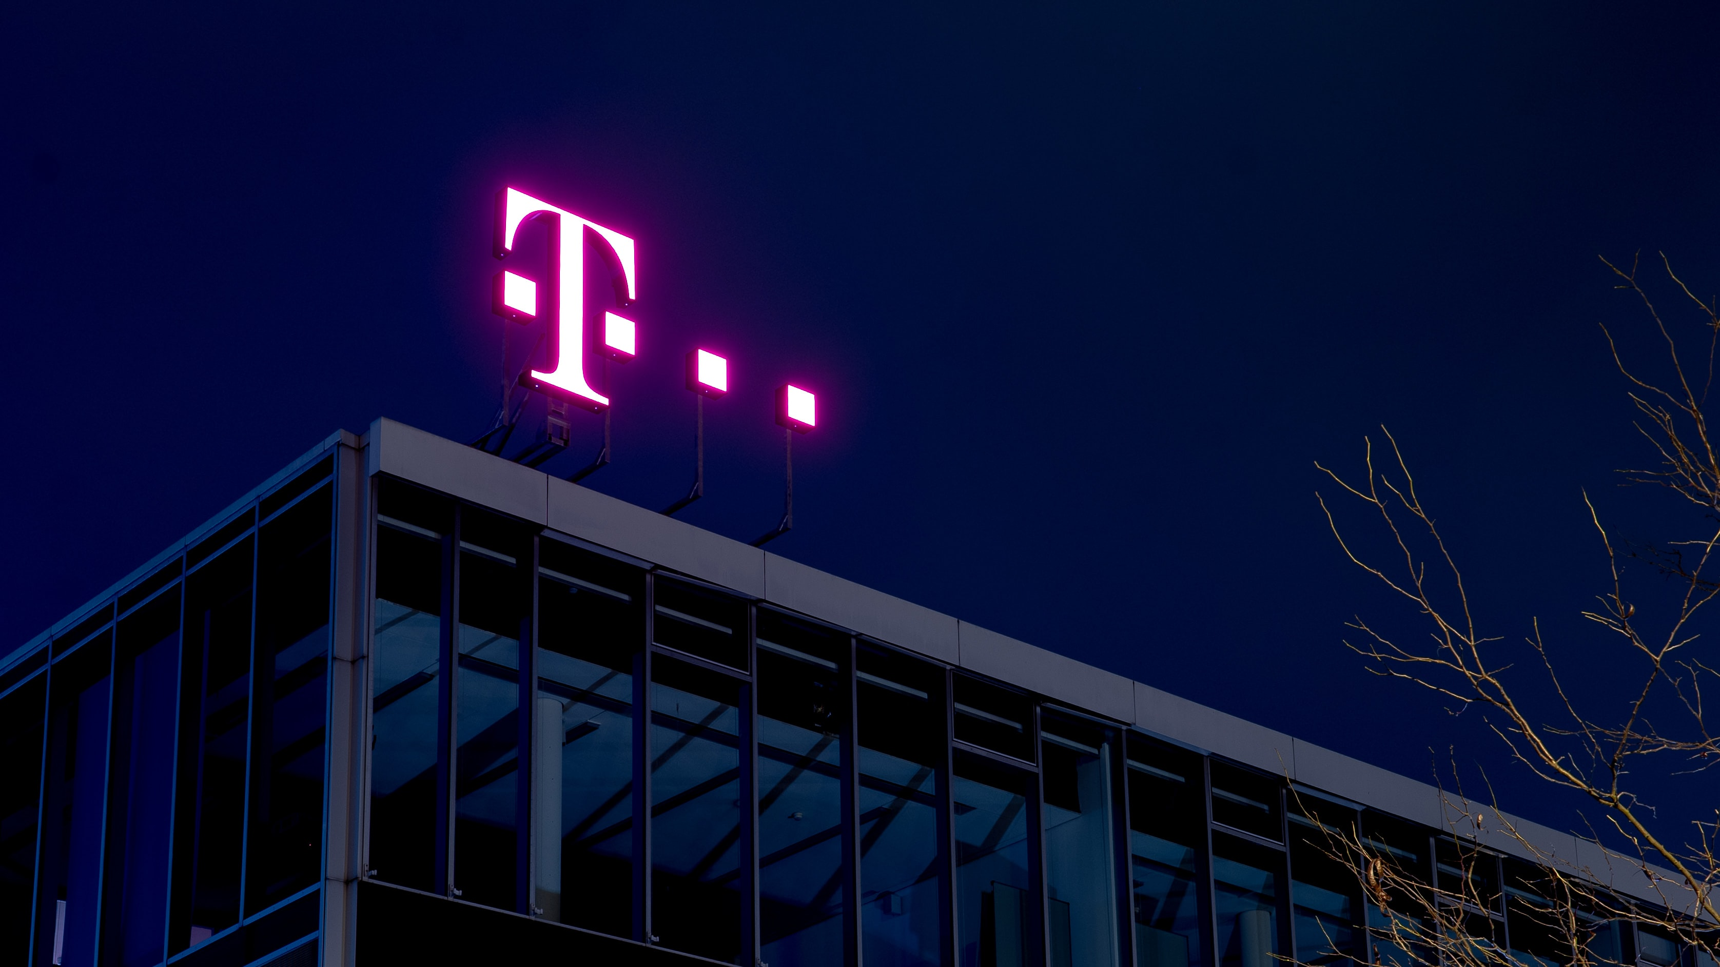
TELECOM CHURN PREDICTION
Group 6
Presented by:
Aditi Agarwal
Mehak Pahwa
Prithvi Chauhan
Akshat Patil
Mayur Tikmani

Slide 2
Overview of the Project
Goals: To prevent the customers who are likely to churn using different techniques and methods.
Objectives: To Predict and study the reason of customer Churning.
Techniques Used: We have used random forest, decision tree and logistic regression

Slide 3




BUSINESS UNDERSTANDING
Intensity of Competitive Rivalry in the Industry
Operator Subscriber Market Share
Industry Analysis
Price Wars
The US Telecom market is majorly operated by 3 Tier-1 national players: AT&T, Verizon and T-Mobile, catering to an overall 96% of the mobile subscriber base
DISH, an MVNO and the newest entrant in the mobile service market post the merger of Sprint and T-Mobile holds 2.3% of the overall subs
US Cellular, a regional carrier, is the fifth carrier holding 1.3% of the overall subscriber base
Other MVNOs include Mint, Comcast (Xfinity Mobile), Charter (Spectrum Mobile), Altice Mobile
T-Mobile as of Q1 2022 claims to have 94% population coverage for 5G, the highest amongst the Tier1s
AT&T leads currently in the highest net additions in the past few quarters based on aggressive handset promotional pricing
Dish
U.S. Cellular
2.3%
1.3%
AT&T
Innovation
Verizon
366M
Coverage
T-Mobile
Customer Service
3
MVNO: Mobile Virtual Network Operator

Slide 4




Overview on the Industry
Positive
Neutral
Negative
Bargaining Power of Suppliers
Low Bargaining Power as T-Mobile has deep pockets
Power Asymmetry due to the size of T-Mobile that gives suppliers low negotiation power
Bargaining Power of Customers
Customer power is significant in the telecom industry.
Easy and inexpensive switch to another provider so understanding churn behaviour is very crucial
Threat of New Entrants
Very low risk of new competitors due to the substantial establishment cost
Labyrinth of government regulations can take years before building a network.
Availability of Substitute Products
Biggest threat of all is carrier substitution from providers like AT&T, Verizon, or Sprint.
Differentiating factor is low with the chasm narrowing by the day.

Slide 5

Firm Description
Founded in 1994
Founded by John W. Stanton
Headquartered in Bellevue, Washington
Number of Operating Locations: 20,100
Number of Employees: Approx. 85,000

Slide 6
Cell phones and other electronics
Tablets
Smart Watches
Portable data devices
Other Cellphone accessories
Cellular and Mobile Data
Student Plans
Family Plans
Senior Citizens Plans
Military and Veterans
MAGENTA PLAN
Television and Streaming
Bundled Television Network
Apple TV
Philo
YouTube TV
Products and Services Offered
Financial Services
T-Money

Slide 7
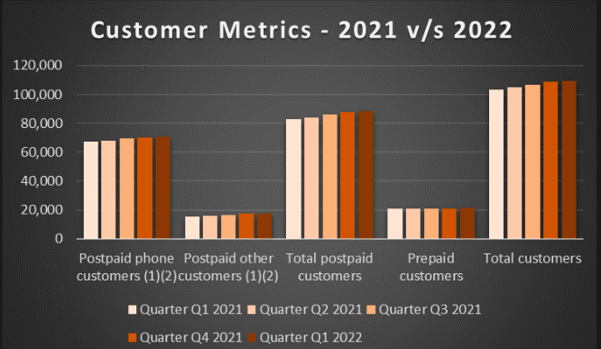
Let's talk Numbers : T-Mobile Customer Base

Slide 8
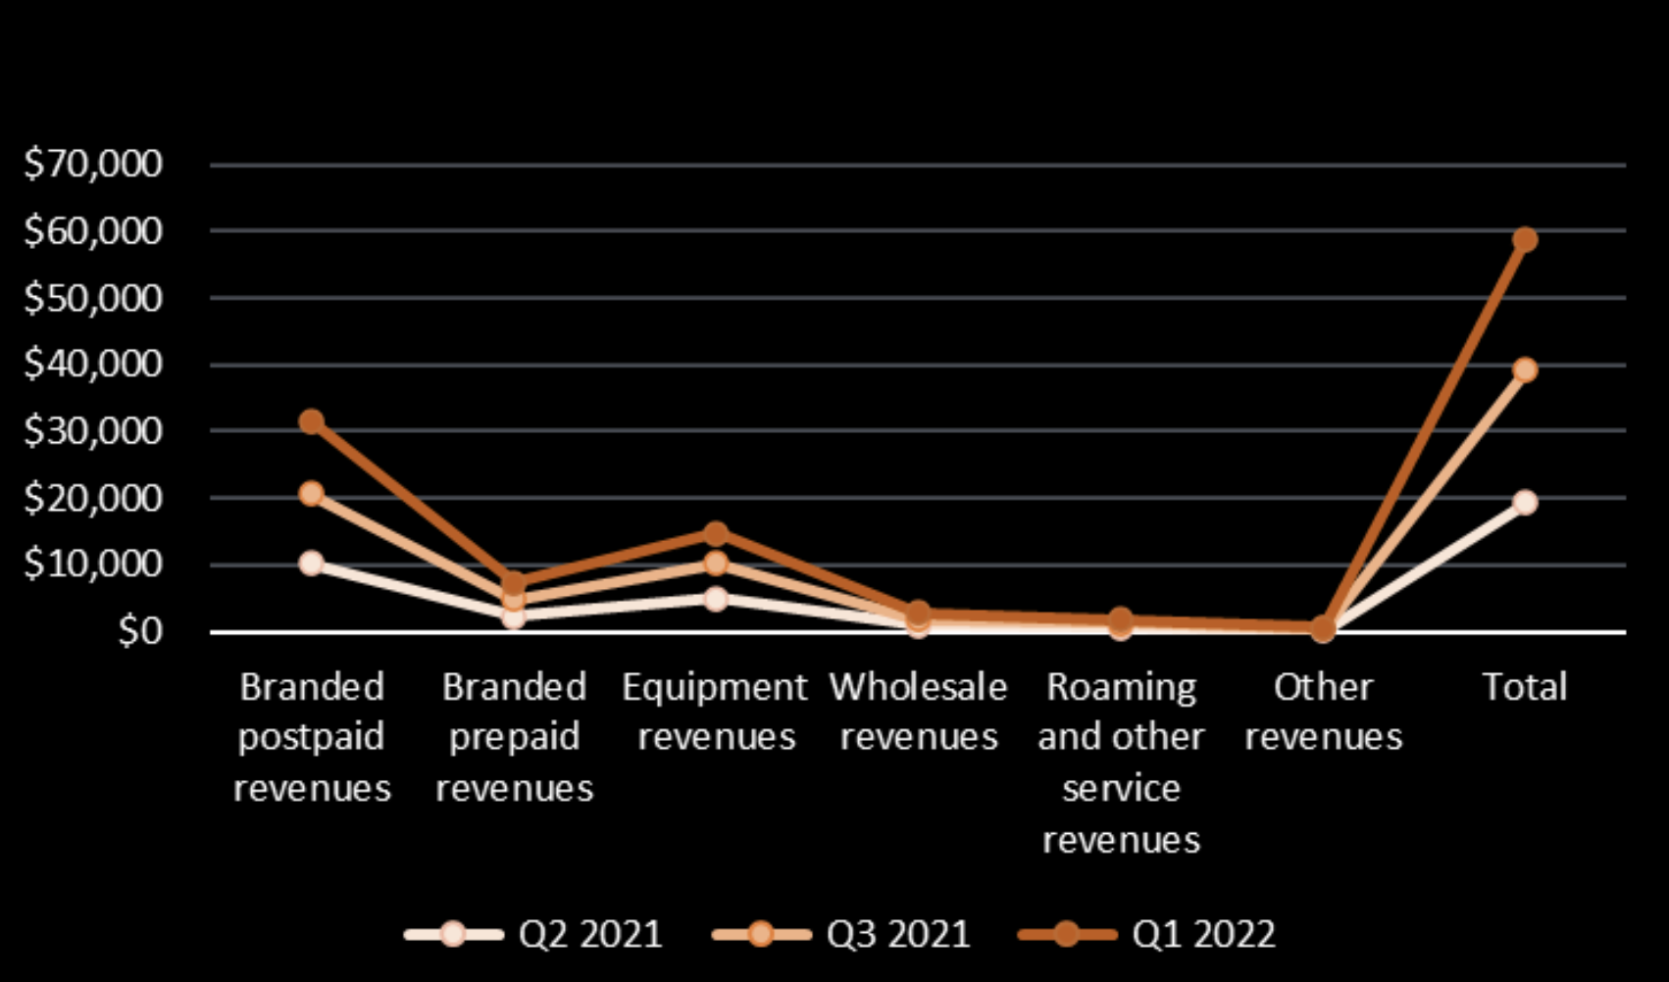
Revenue Projections

Slide 9
Strength
Competitive edge - holds major market share
Strong Distribution Network
Good Returns on New Products and Services
Strong Customer Base - wide segmentation
Opportunity
Expansion in 5g Services
Economic Uptick and Increased Customer spending.
Merger with sprint adding to investment and brand image
Weakness
Network Performance Issues- Outages and high buffer rate.
High attrition rate in workforce
Need larger investment in R&D to support new technological additions
Threat
Emergence of competitive firms
Adverse impact of Pandemic on Business Operations, in terms of economy and consumer demand
Cyber Threat of security breach and data loss

Slide 10
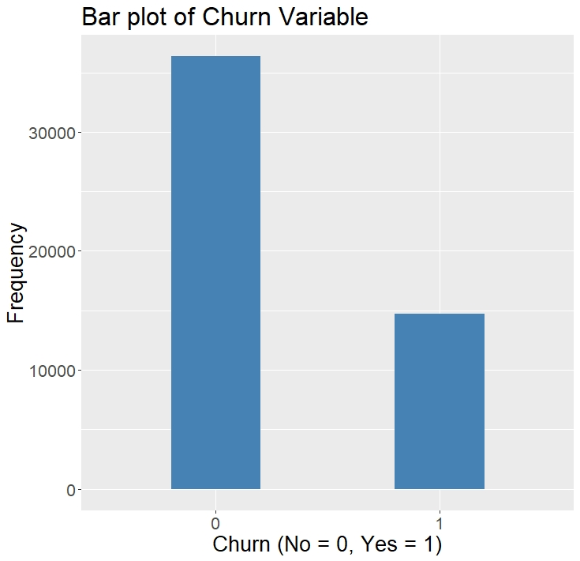
DATA ANALYSIS AND UNDERSTANDING Data Description
Independent Variables
Target Variable of Interest
Data Source
Kaggle.com
https://www.kaggle.com/datasets/jpacse/datasets-for-churn-telecom
Churn Rate
71% No 29% Yes
56 variables (Top 10)
Current Equipment days
Perc Change Minute
Monthly Minutes
Total Recurring Charge
Off Peak Calls In Out
Peaks Calls In Out
Months in Service
Received Calls
Unanswered Calls
Monthly Revenue
Outbound Calls
Number of Records
51,047 Records

Slide 11

Yes : 36336
No : 14711

Slide 12
Variable Description
Current Equipment Days –Number of days of the current equipment
Perc Change Minute- % change in minutes of use
Monthly Minutes- Total usage minutes in a month
Total Recurring Charge- Mean total recurring charges
Off Peak Calls In Out- Mean number of In and Out Calls during off Peak Hours
Peaks Calls In Out- Mean number of In and Out Calls during Peak Hours ( 8am – 9pm)
Months in Service- Months in Service for every customer
Received Calls- Mean Received Voice Calls
Unanswered Calls – Mean Number of Unanswered Calls
Monthly Revenue – Mean Monthly Revenue
Outbound Calls – Mean number of Outbound Calls

Slide 13
Summarizing the Data Set
Summary | Mean | Standard Deviation | Minimum | Maximum | Median
CurrentEquipmentDays | 380.5448 | 253.7996 | -5 | 1812 | 329
MonthsInService | 18.756264 | 9.800138 | 6 | 61 | 16
PercChangeMinutes | -11.50083 | 256.58799 | -3875 | 5192 | -5
MonthlyMinutes | 525.1655 | 529.1342 | 0 | 7359 | 366
OffPeakCallsInOut | 67.65079 | 92.7527 | 0 | 1474.7 | 35.7
TotalRecurringCharge | 46.8245 | 23.81262 | -11 | 400 | 45
PeakCallsInOut | 90.54952 | 104.94747 | 0 | 2090.7 | 62
MonthlyRevenue | 58.80279 | 44.44296 | -6.17 | 1223.38 | 48.46
ReceivedCalls | 114.8001 | 166.4859 | 0 | 2692.4 | 52.8
UnansweredCalls | 28.28898 | 38.87619 | 0 | 848.7 | 16.3
Churn | 0.2881854 | 0.4529223 | 0 | 1 | 0

Slide 14
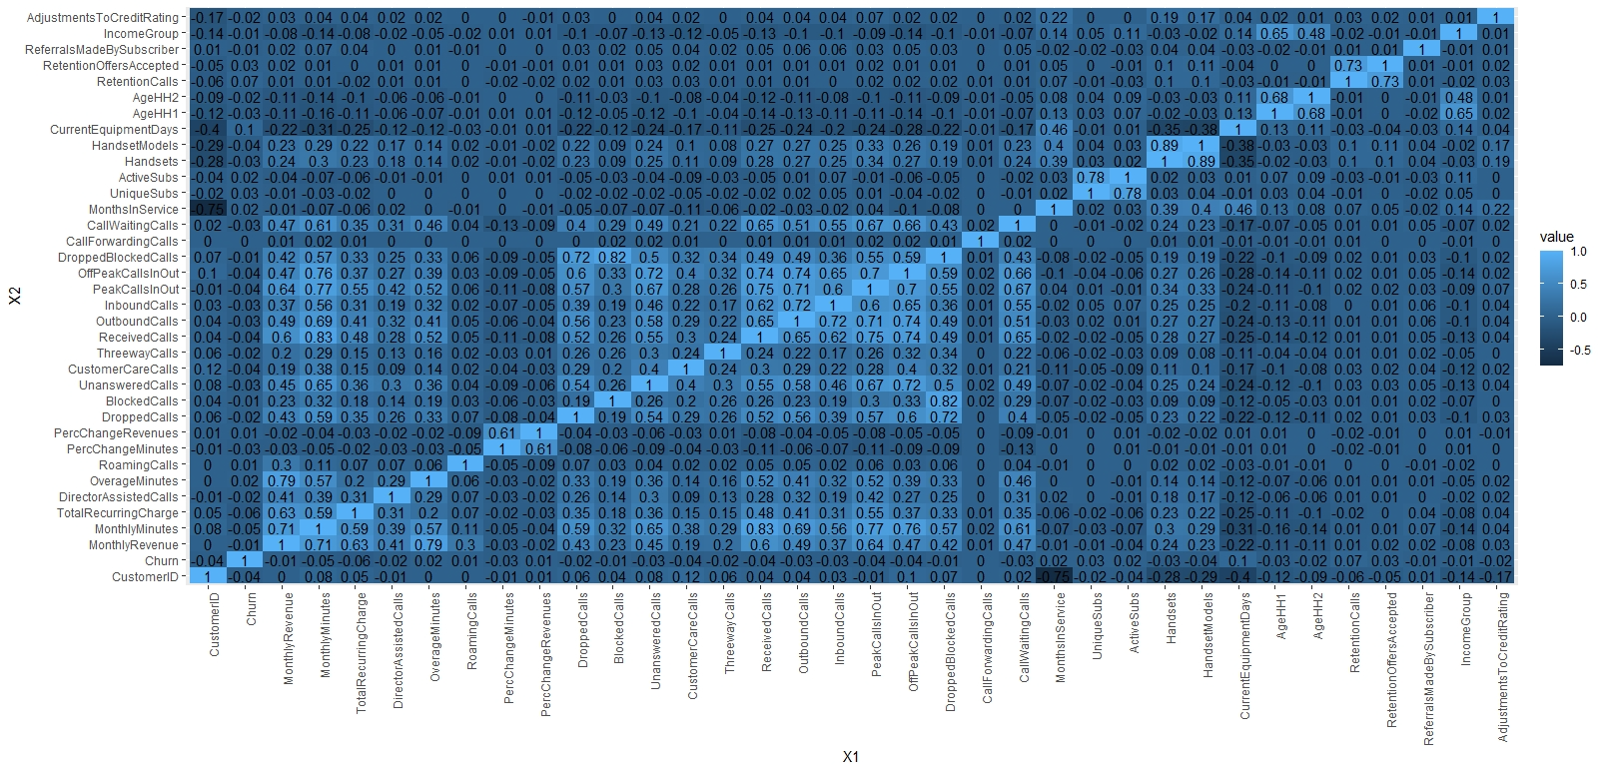
Correlation Matrix of all the Numeric Variables

Slide 15
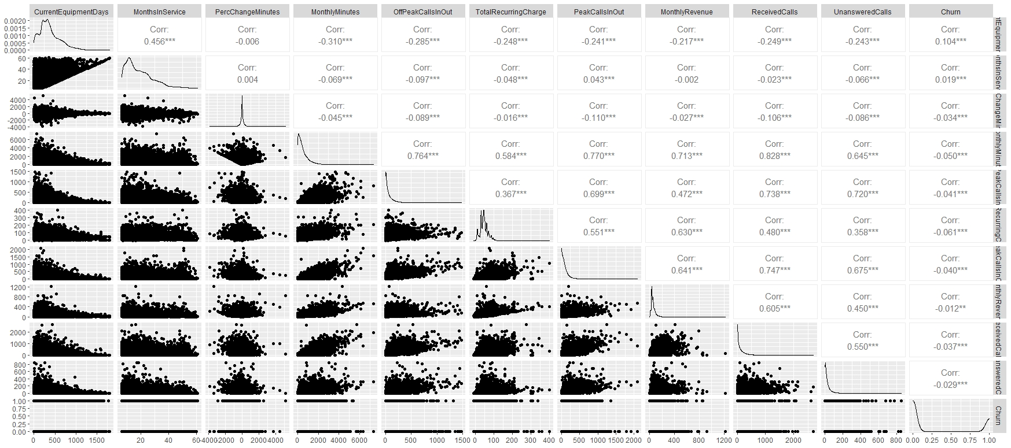
Scatter Plot Matrix of Top 10 Variables

Slide 16

Data Modeling Goals And Objectives
•Churn is our predictive variable of character datatype in the form of “Yes” and “No”. We have converted it into “1” and “0” as it’s easier for us to use it in our models.
•Our main goal is to predict whether the customers with our telecom provider T-Mobile will churn or not and what are the main reasons for them to churn.
•Our main aim is to get a predictive model which is the most effective taking into consideration the monthly revenue lost due to the customers churning and the promotional cost required to make them stay.

Slide 17
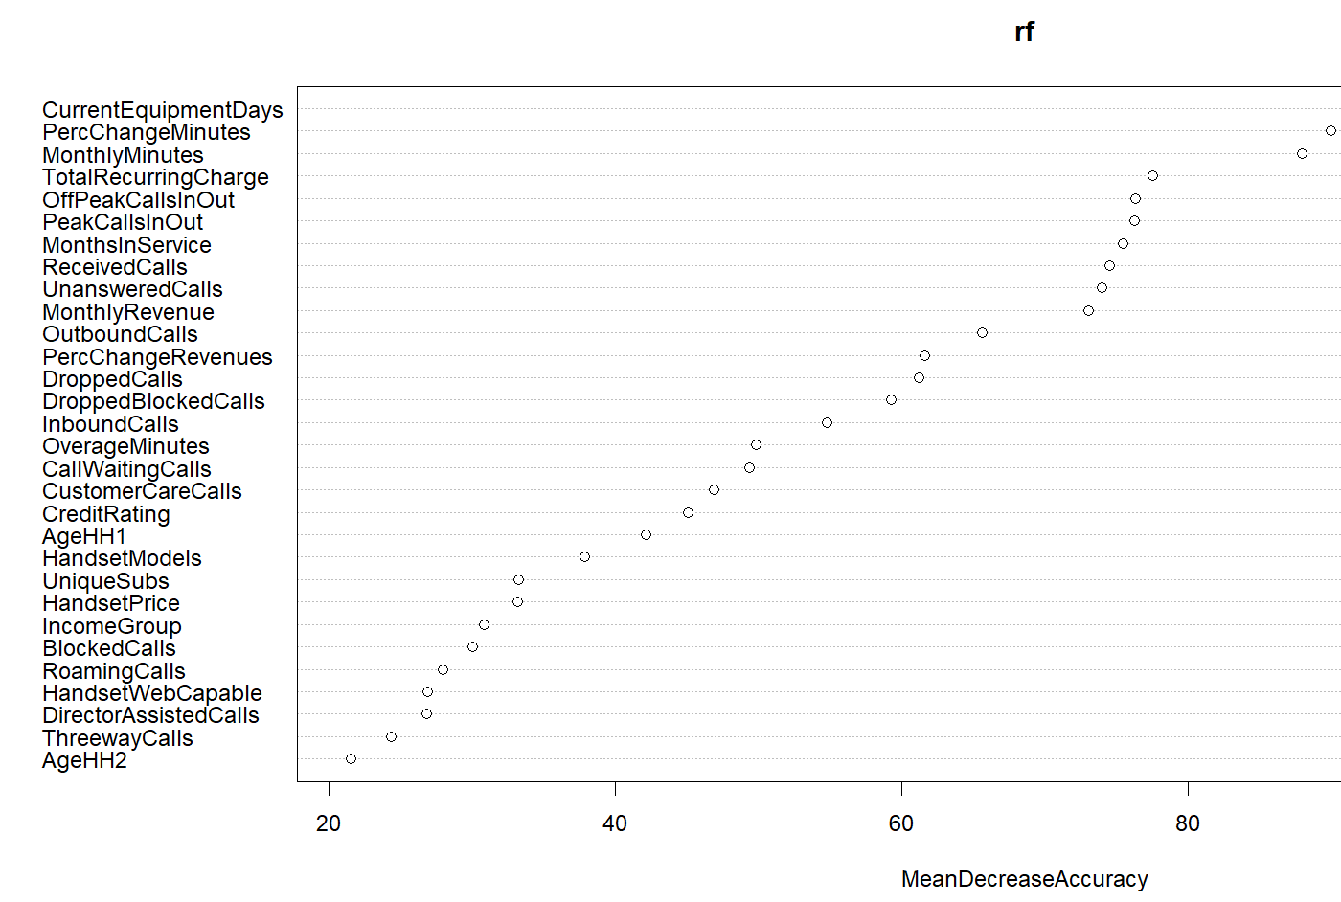
Random forest: Key Variables

Slide 18
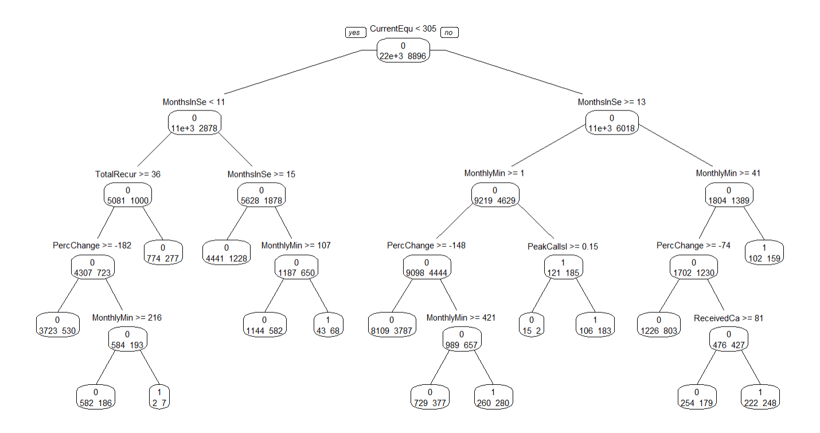
Decision Tree with Top 10 Variables

Slide 19
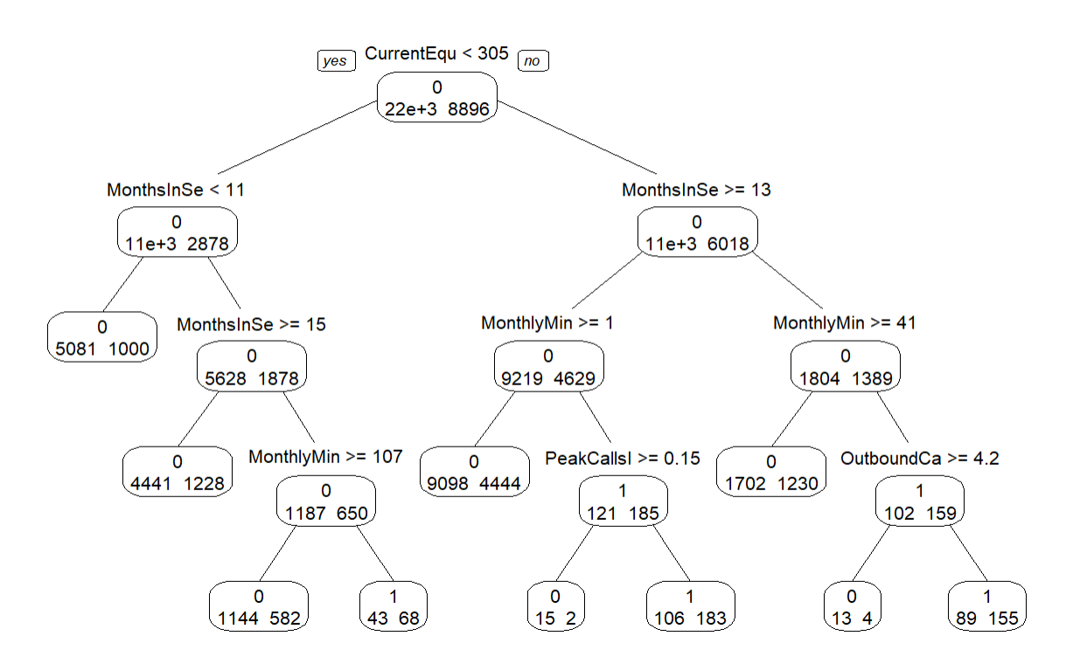
Decision Tree with Top 15 Variables

Slide 20
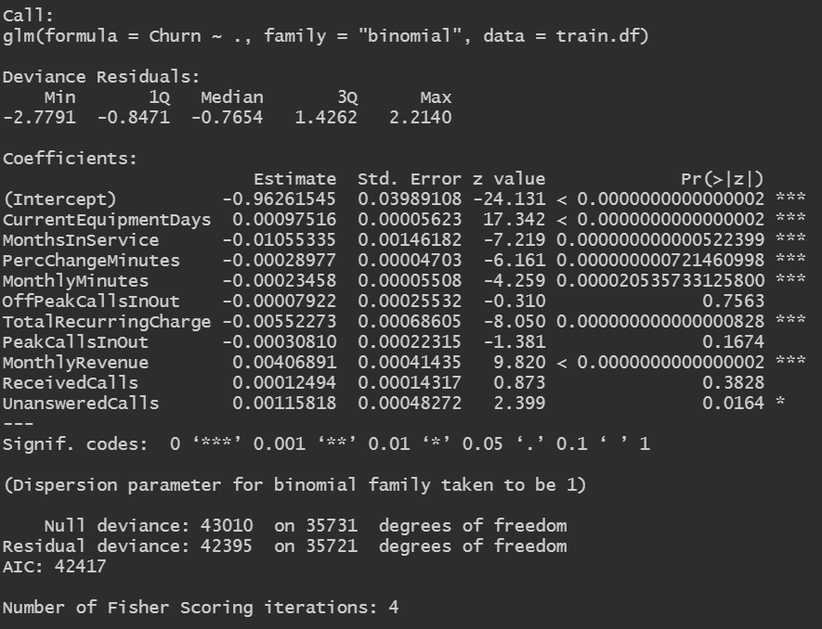
Logistic Regression Model

Slide 21
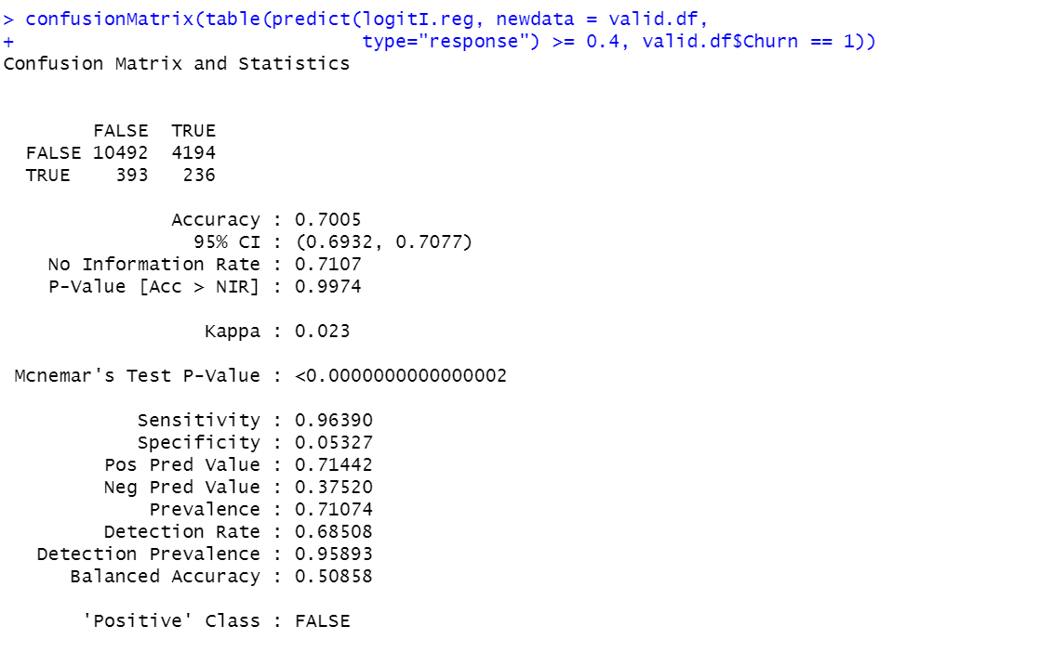
Logistic Regression Analysis using cutoff value 0.4

Slide 22
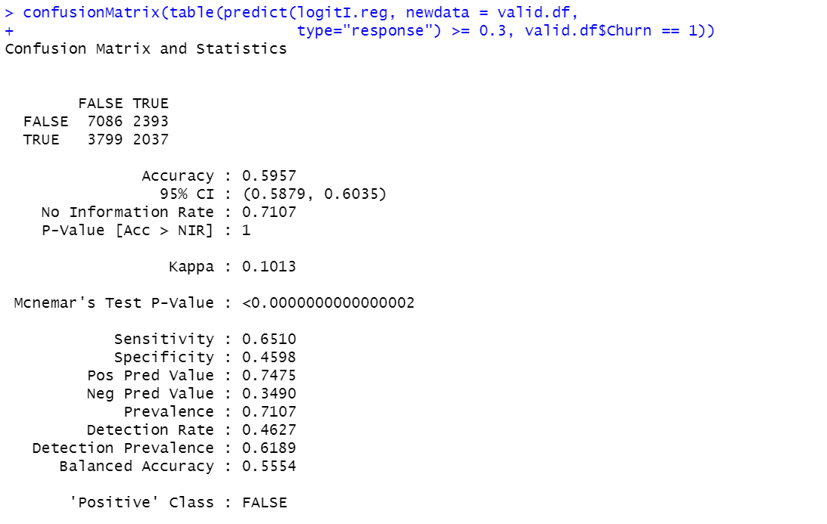
Logistic Regression Analysis using cutoff value 0.3

Slide 23
Evaluating the Performance of different Models
Model Name | Random Forest | Decision Tree ( 10 Variable) | Decision Tree ( 15 Variable) | Logistic Regression (cutoff =0.4) | Logistic Regression (cutoff =0.3)
Accuracy | 0.7245 | 0.7164 | 0.7181 | 0.7005 | 0.5957
Sensitivity | 0.9635 | 0.96549 | 0.98843 | 0.96390 | 0.6510
Specificity | 0.1242 | 0.09097 | 0.03904 | 0.05327 | 0.4598

Slide 24
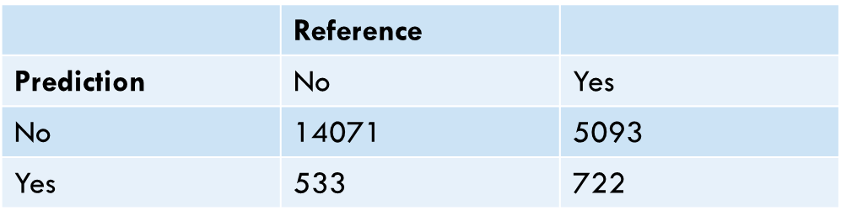
COST BASED CLASSIFICATION : RANDOM FOREST
Promotional Cost for one customer: 46 ; Revenue Loss if customer churns : 500
Cost : (46 * 533) + (500 * 5093) = $ 2571018

Slide 25
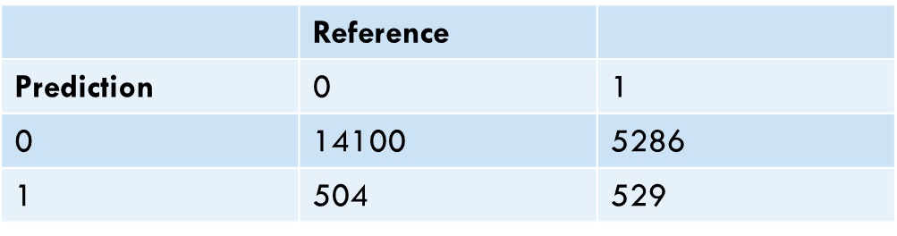
COST BASED CLASSIFICATION : DECISION TREE 10 VARIABLES
Promotional Cost for one customer: 46 ; Revenue Loss if customer churns : 500
Cost : (46 * 504) + (500 * 5286) = $ 2666184

Slide 26
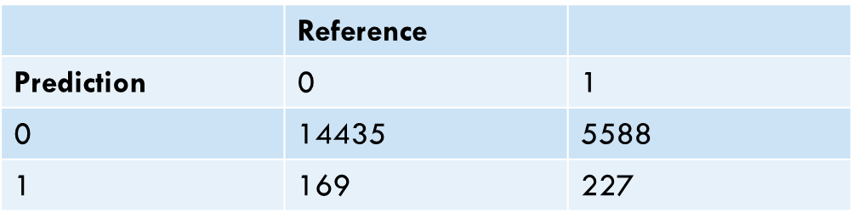
COST BASED CLASSIFICATION : DECISION TREE 15 VARIABLES
Promotional Cost for one customer: 46 ; Revenue Loss if customer churns : 500
Cost : (46 * 169) + (500 * 5588) = $ 2801774

Slide 27
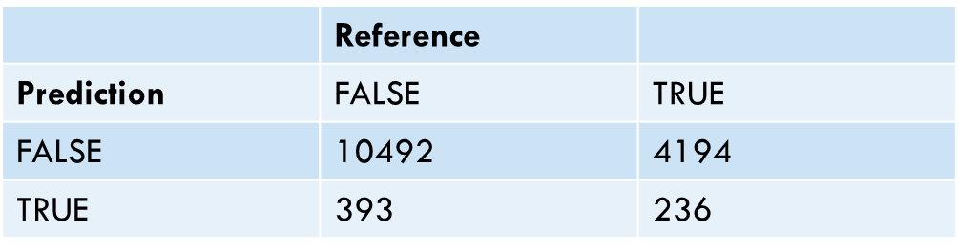
COST BASED CLASSIFICATION : LOGISTIC REGRESSION 0.4
Promotional Cost for one customer: 46 ; Revenue Loss if customer churns : 500
Cost : (46 * 393) + (500 * 4194) = $ 2115078

Slide 28
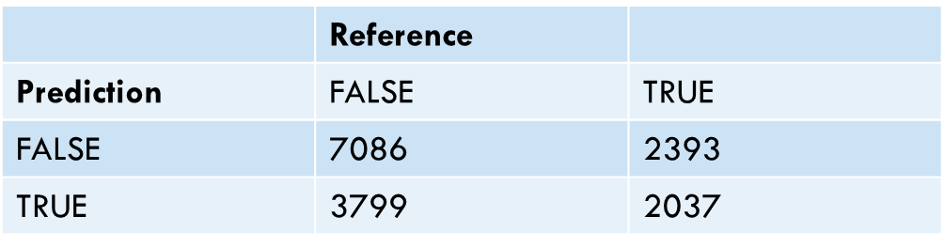
COST BASED CLASSIFICATION : LOGISTIC REGRESSION 0.3
Promotional Cost for one customer: 46 ; Revenue Loss if customer churns : 500
Cost : (46 * 3799) + (500 * 2393) = $1371254

Slide 29
Inference from the cost analysis across our models
Upon comparing the multiple models that we used to Predict the Churn Rate, we observe and infer that the model deploying Logistic Regression with a cutoff of 0.3 produces the least cost of mis-identifying the customers who Churn.

Slide 30
Limitations in our Model
Logistic regression model is sensitive to outliers.
The minority class of Churn variable in our dataset is Yes which is only 29%,if there was slightly more data of the customers who churned, our model would have achieved a better accuracy and the cost of misidentifying false prediction would be comparatively less.
It is required that each training example be independent of all the other examples in the dataset. If they are related in some way, then the model will try to give more importance to those specific training examples.

Slide 31
Upgrading customer's equipment with a lock-in of more than 365 days : Target using Email Marketing
Special Low Usage Plans for Users who are likely to churn due to high monthly recurring charge : Retention Calls, Email Marketing
Reward customers on the basis of their loyalty. Provide annual credits for every additional year and provide premium services
Target customers, who will likely churn through website promotion pop-up, push notifications and in-app notifications. Eg- Low Monthly Minutes Usage Customer be targeted through push notification offers
RECOMMENDATIONS TO REDUCE THE CHURN RATE

Slide 32
Appendix
Please find the Link to our R-Script below:
https://utdallas.box.com/s/9rxmhvo2i0rz59h20kc22rfgqvl1yimj
Links to our research resources:
T-Mobile US, Inc. - Financials - Annual Reports & Proxy Statements
Inline XBRL Viewer (sec.gov)
http://fernfortuniversity.com/term-papers/swot/nyse/3976-t-mobile-us--inc-.php
https://www.swotandpestle.com/t-mobile/
https://www.kaggle.com/datasets/jpacse/datasets-for-churn-telecom

Slide 33

Thank You

